Slide 1
CP2404/CP5633 Database Modelling
Lecture 01

Slide 2
Lecture 1
Introduction to Database System
Reading: Coronel’s Chapter 1
Notes:
2

Slide 3
Learning Objectives
In this lecture, you will learn:
The terms: data, information, database, DBMS
The importance of database design
Evolution of files and database systems
Main components of the database system
Main functions of a DBMS
Notes:
3

Slide 4
Data, Information, DB, DBMS
The importance of database design
Notes:
4

Slide 5
Data vs. Information
Data:
Raw facts; building blocks of information
Unprocessed information
Information:
Data processed to reveal meaning
Accurate, relevant, and timely information is key to good decision making
Good decision making is the key for business to survival in a global environment
Notes:
5

Slide 6
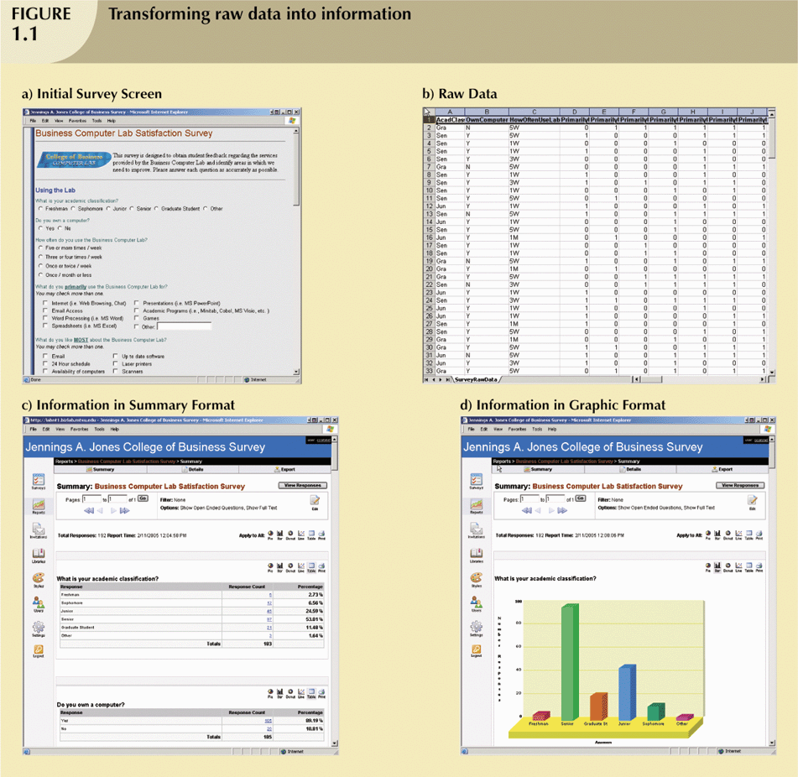
Data vs. Information
Database Management System
(DBMS)
Database
(DB)
Notes:
6

Slide 7
So, what is a Database (DB)?
A DATABASE
is a managed (specialised & integrated) collection
of associated data stored in a computer system
shared by multiple users
protected with security measures
stored with controlled redundancy
retrieved quickly
Notes:
7

Slide 8
Daily Activities that Involve DBs
Purchase from the supermarket
Purchase using your credit card
Booking a tour at the travel agents
Borrowing from the library
Checking your Facebook or Twitter accounts
….
Nearly every computer-based activities in our modern society
Notes:
8

Slide 9

Do this now
Purchase from the supermarket
Purchase using your credit card
Booking a tour at the travel agents
Borrowing from the library
Checking your Facebook or Twitter accounts
….
From examples of our daily-activities as given above, try to find some examples of raw data, information and databases.

Slide 10
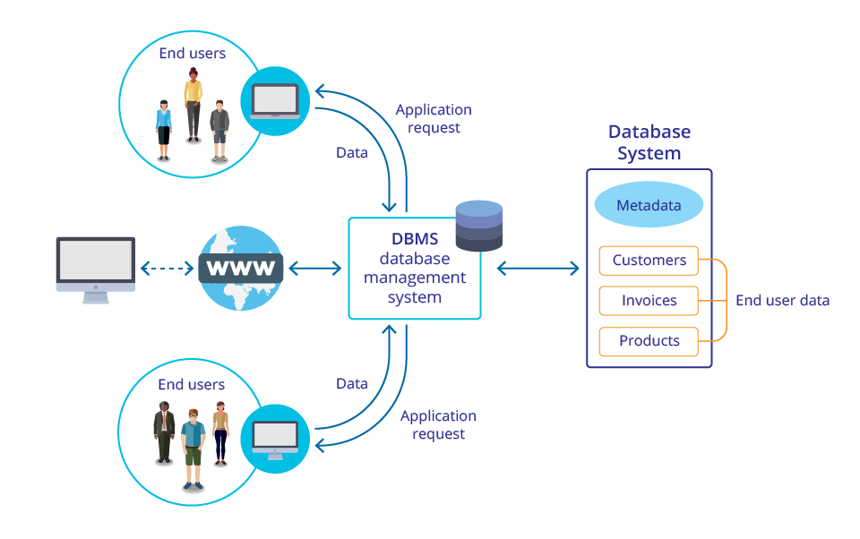
Warming Up Discussion
What can you perceive throughout this figure?

Slide 11
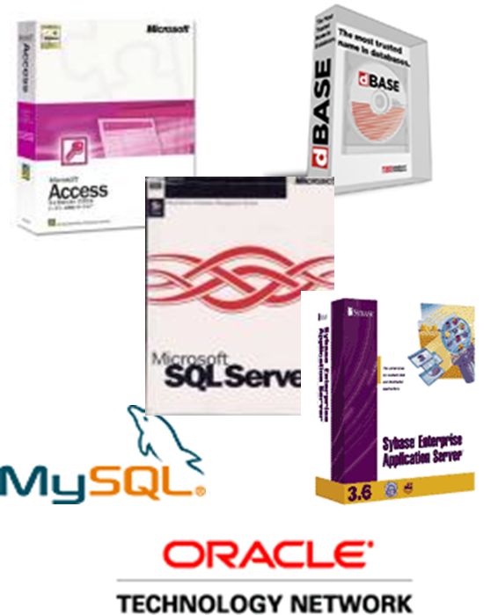

So, what is a Database Management System (DBMS)?
Database Management System (DBMS)
is a program,
or a collection of programs, through which
users interact with
a database

Slide 12
DB vs. DBMS
Database (DB)
like a well-organised electronic filing cabinet
Database Management System (DBMS)
helps manage the cabinet’s contents

Slide 13
The DBMS Manages the Interaction between the End-User and the DB
DB & DBMS

Slide 14
Roles of the DBMS
Intermediary between the user and the database
Enables data to be shared
Presents the end user with an integrated view of the data
Receives and translates application requests into operations required to fulfill the requests
Hides database’s internal complexity from the application programs and users

Slide 15
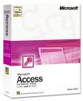
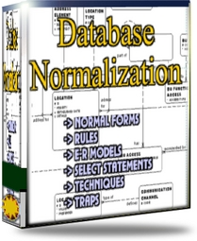
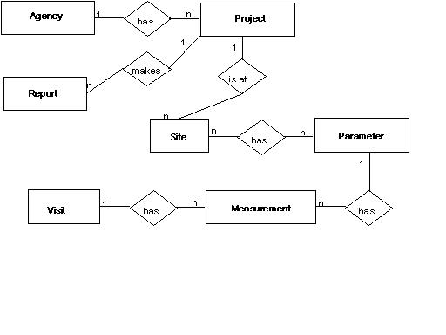

What’s this subject about?
Database Management Systems
✓
Models
Designs
SQL
THEORY

Slide 16
What’s this subject about?
One of the Major Objectives of this subject is …
Learning
how to develop
a well-designed
database
Notes:
16

Slide 17
The Importance of DB Design
Poorly designed DB
generates errors
leads to bad decisions
can lead to failure of organization
Well-designed DB
facilitates data management
(e.g. avoid redundant data)
generates accurate and valuable information
helps decision making
business success
17
Notes:
17

Slide 18
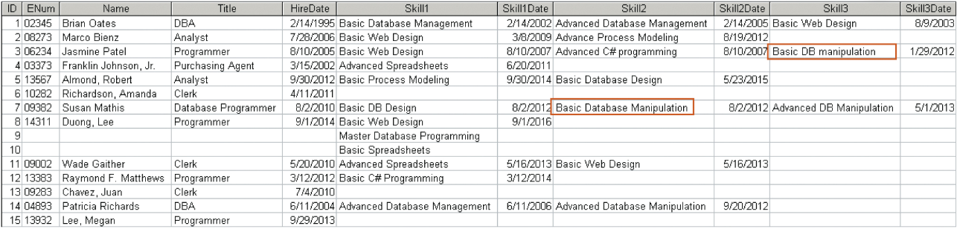
Warming Up Discussion
What’s the problem with keeping the data in this form?

Slide 19
Warming Up Discussion
What’s the problem with keeping the data in this form?
Student_ID | FirstName | LastName | Address1 | Address2 | Postcode | Subject_id | Subject_name | Session
1257896 | Kevin | Wilkins | Smith Street | Oberon | 2787 | CP1500 | Database | SP2
3256782 | Brad | Curry | Fred Street | Lithgow | 2790 | CP1500 | Dbase Systems | SP2
5632458 | Jim | Tulip | Howick Street | Bathurst | 2795 | CP1500 | Data Mgt | SP2
2465823 | Jenny | Walker | Main Street | Orange | 2800 | CP2402 | Operating System | SP2
1257896 | Kevin | Wilkins | Smith Street | Oberon | 2787 | CP1300 | Programming II | SP2
3256782 | Brad | Curry | Fred Street | Lithgow | 2790 | CP1300 | Intro Programming | SP2
5632458 | Jim | Tulip | Howick Street | Bathurst | 2795 | CP1300 | programming | SP2

Slide 20
Databases aim to reduce redundancy !!
Redundancy
(duplication of data or the storing of the same data in more than one place)
Problems with redundancy
Data becomes inaccurate.
If a certain field (e.g. address) occurs in the database several times errors will result if all occurences are not updated when the field value changes. Then users don't know which answer is correct and confidence in this system disappears.
Extra data entry time.
As the same data is entered several times. This also lead to errors due to typing mistakes.
Extra data storage.
This is a minor problem as storage is so cheap these days.

Slide 21
In a Database,
Data is
formatted / integrated / structurised
How?
... You will learn that through this subject ...
Notes:
21

Slide 22
Evolution of file systems and database systems
Types of databases
Notes:
22

Slide 23
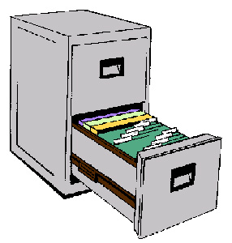
Data Before DB & DBMS
Evolution of File Systems
Manual File Systems
Accomplished through a system of file folders and filing cabinets
Computerized File Systems
Data processing (DP) specialist: Created a computer-based system that would track data and produce required reports
File System Redux: Modern End-User Productivity Tools
Includes spreadsheet programs such as Microsoft Excel

Slide 24
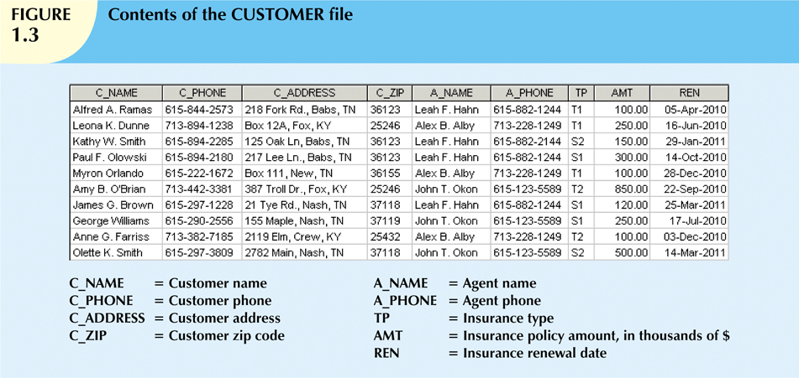
Example of Computer Data File
Notes:
24

Slide 25
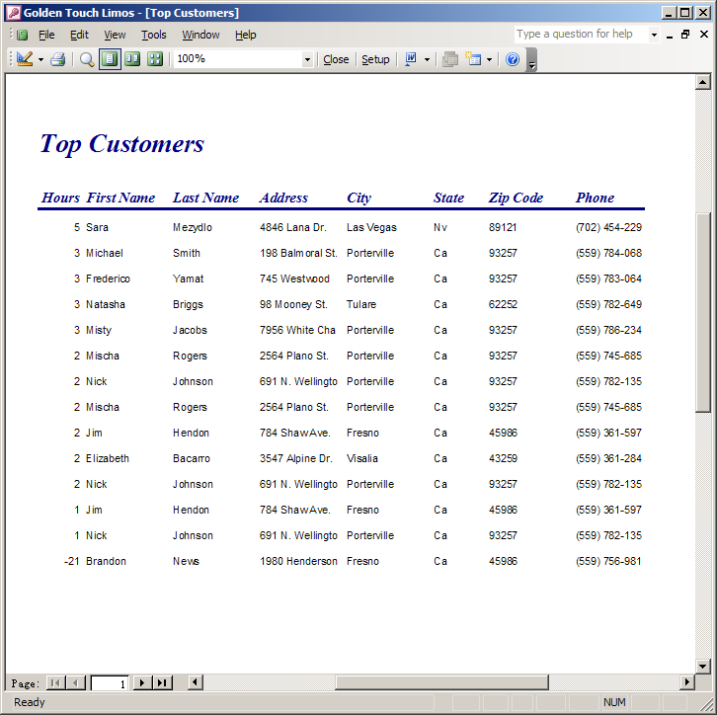
Example of Computer Data File
File
Collection of related records
Field
Group of characters with specific meaning
Record
Logically connected fields that describe a person, place, or thing
Data
Raw Facts
Notes:
25

Slide 26
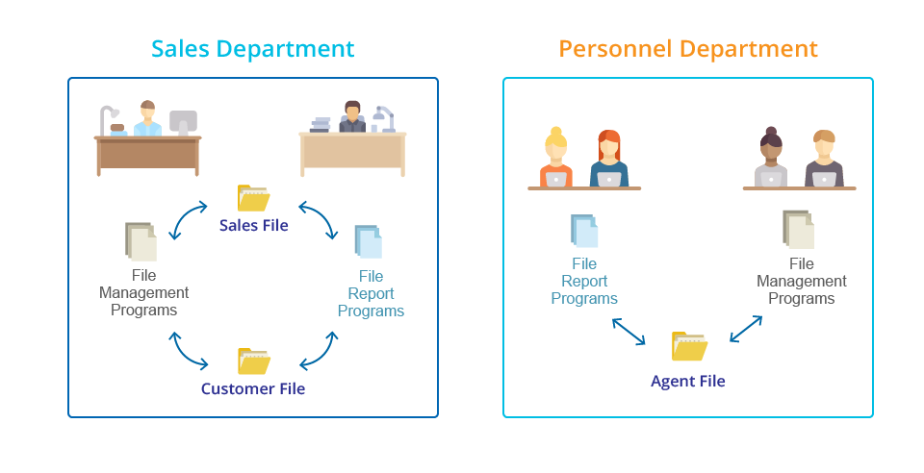
A Simple File System

Slide 27
Warming Up Discussion
What are potential problems of the file system?
Notes:
27

Slide 28
Problems with File System for
Data Processing
Lengthy development times
Difficulty of getting quick answers
Complex system administration
Lack of security and limited data sharing
Extensive programming
Notes:
28

Slide 29
Problems with File System for
Data Processing
Structural dependence
Access to a file depends on its own structure, e.g. the order of the fields → All file system programs are modified to conform to a new file structure
Data dependence
Changes in the data storage characteristics (the length and data type of fields) affecting the application program’s ability to access the data
Data Redundancy
Different and conflicting versions of the same data appear in different places unnecessarily
Results in data inconsistency and poor data security
Data Anomalies
Develop when required changes in redundant data are not made successfully
Update anomalies, insertion anomalies and deletion anomalies
Notes:
29

Slide 30
Do this now
What is data redundancy, and which characteristic of the file system can lead to it?
What is data independence, and why it is lacking in file system?
What is structural independence, and why is it important?

Slide 31
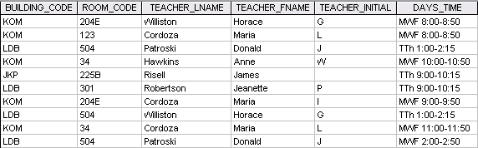
Do this now
This file contains data for a teacher-class assignment schedule.
Identify and discuss the serious data redundancy problems implied in this file structure.
What problem would you encounter if building KOM were deleted?

Slide 32
Evolution of DB & DBMS
Problems inherent in file systems making using a database system desirable
Database(DB)—shared, integrated computer structure that stores:
End user data (raw facts)‏
Metadata (data about data)‏
DBMS (database management system):
Collection of programs that manages database structure and controls access to data
Notes:
32

Slide 33
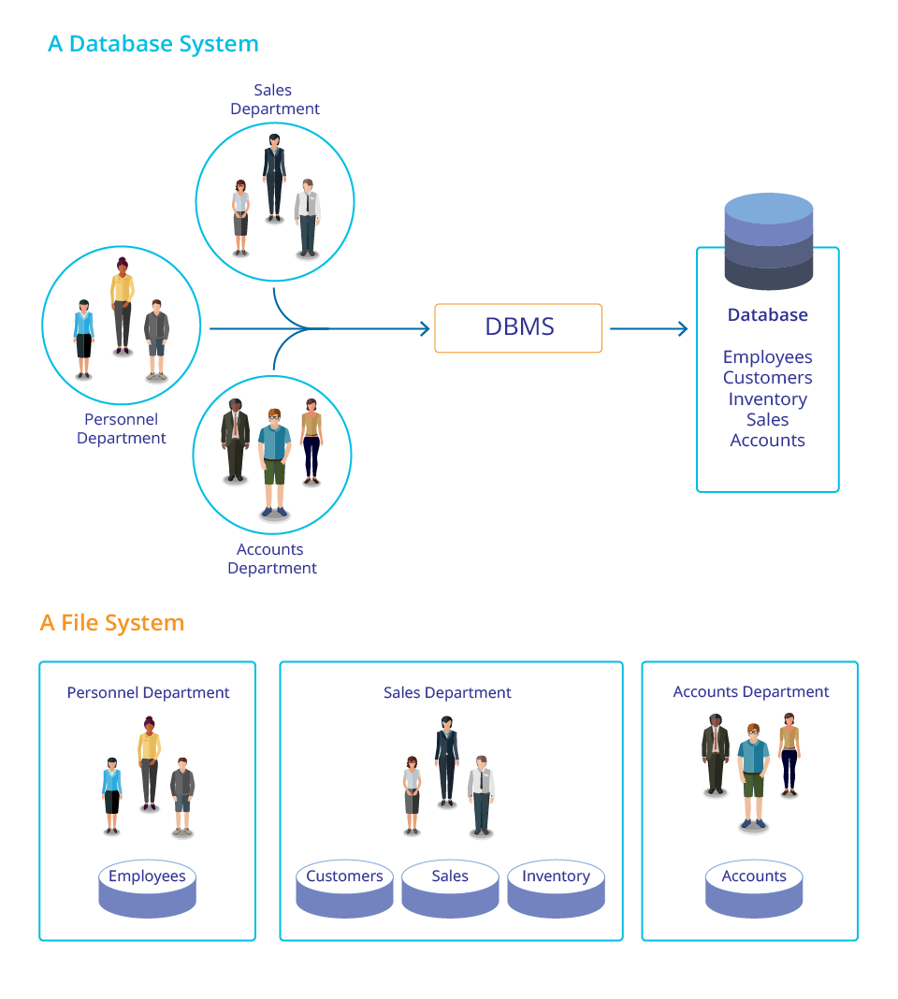
DB Systems vs. File Systems
Notes:
33

Slide 34
Types of Databases –by users
Single-user DB:
Supports only one user at a time
Desktop DB:
Single-user database running on a personal computer
Multi-user DB:
Supports multiple users at the same time
Workgroup DB:
supports a small group of users or a single department
Enterprise DB:
supports a large group of users or an entire organisation

Slide 35
Types of Databases –by location
Centralised DB:
Supports data located at a single site
Distributed DB:
Supports data distributed across several sites
Cloud DB:
Created and maintained using cloud data services that provide defined performance measures for the database

Slide 36
Types of Databases –by use
Transactional (or Operational) DB:
Supports a company’s day-to-day operations
Analytical (Data warehouse) DB:
Stores data used to generate information required to make tactical or strategic decisions
Often used to store historical data
Structure is quite different
Notes:
36

Slide 37
Components of the DB system
Functions of a DBMS
Notes:
37

Slide 38
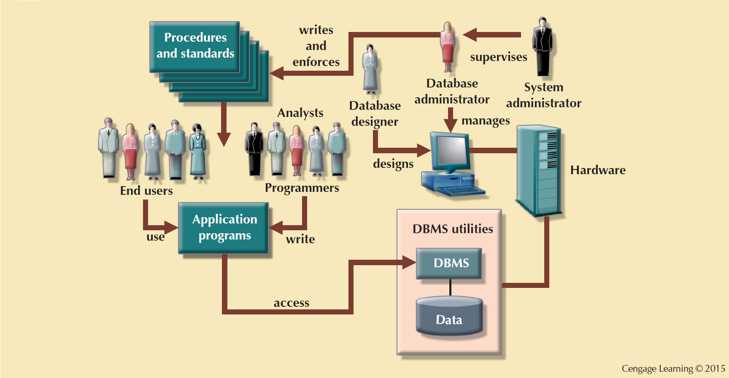
The Database System Environment
Database system is composed of five main parts:
Hardware
Software
Operating system
software
DBMS software
Application programs
and utility software
People
Procedures
Data
Notes:
38

Slide 39
DBMS Functions
Data dictionary management
Data dictionary: Stores definitions of the data elements and their relationships
Data storage management
Performance tuning: Ensures efficient performance of the database in terms of storage and access speed
Data transformation and presentation
Transforms entered data to conform to required data structures
Security management
Enforces user security and data privacy

Slide 40
DBMS Functions
Multiuser access control
Sophisticated algorithms ensure that multiple users can access the database concurrently without compromising its integrity
Backup and recovery management
Enables recovery of the database after a failure
Data integrity management
Minimizes redundancy and maximizes consistency

Slide 41
DBMS Functions
Database access languages and application programming interfaces
Query language: Lets the user specify what must be done without having to specify how
Structured Query Language (SQL): De facto query language and data access standard supported by the majority of DBMS vendors
Database communication interfaces
Accept end-user requests via multiple, different network environments

Slide 42
Advantages of Database Systems
Improved data sharing
Better data integration and security
Minimized data inconsistency
Improved data access
Improved decision making
Increased end-user productivity
Notes:
42

Slide 43
Do this now
How are the problems inherent in the file system (data redundancy, data/structure dependence and data anomalies) addressed in the database system?

Slide 44
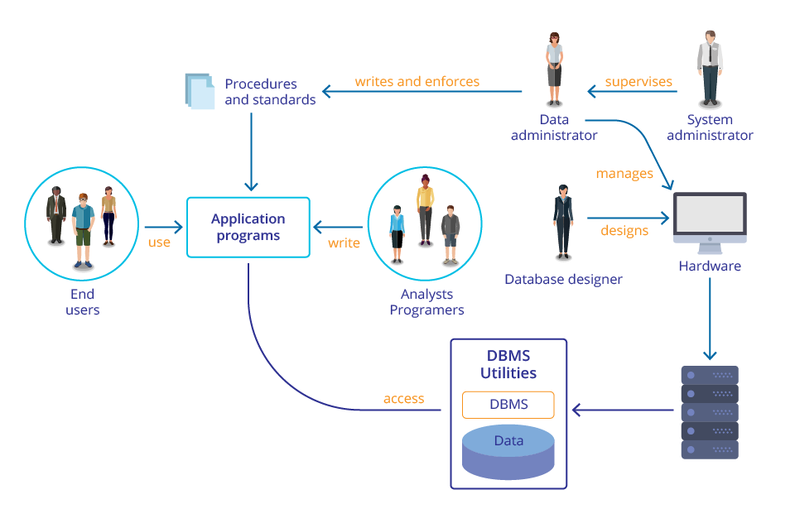
Do this now
Describe the five types of users identified in a database system and roles of each type of users.

Slide 45
Disadvantages of Database Systems
Increased costs
Management complexity
Maintaining currency
Vendor dependence
Frequent upgrade/replacement cycles
Notes:
Having computerized database management system does not guarantee that data will be properly used to provide best solutions required by managers
Introduction of a DBMS is likely to have a profound impact, which might be positive or negative, depending on how it is administered
45

Slide 46
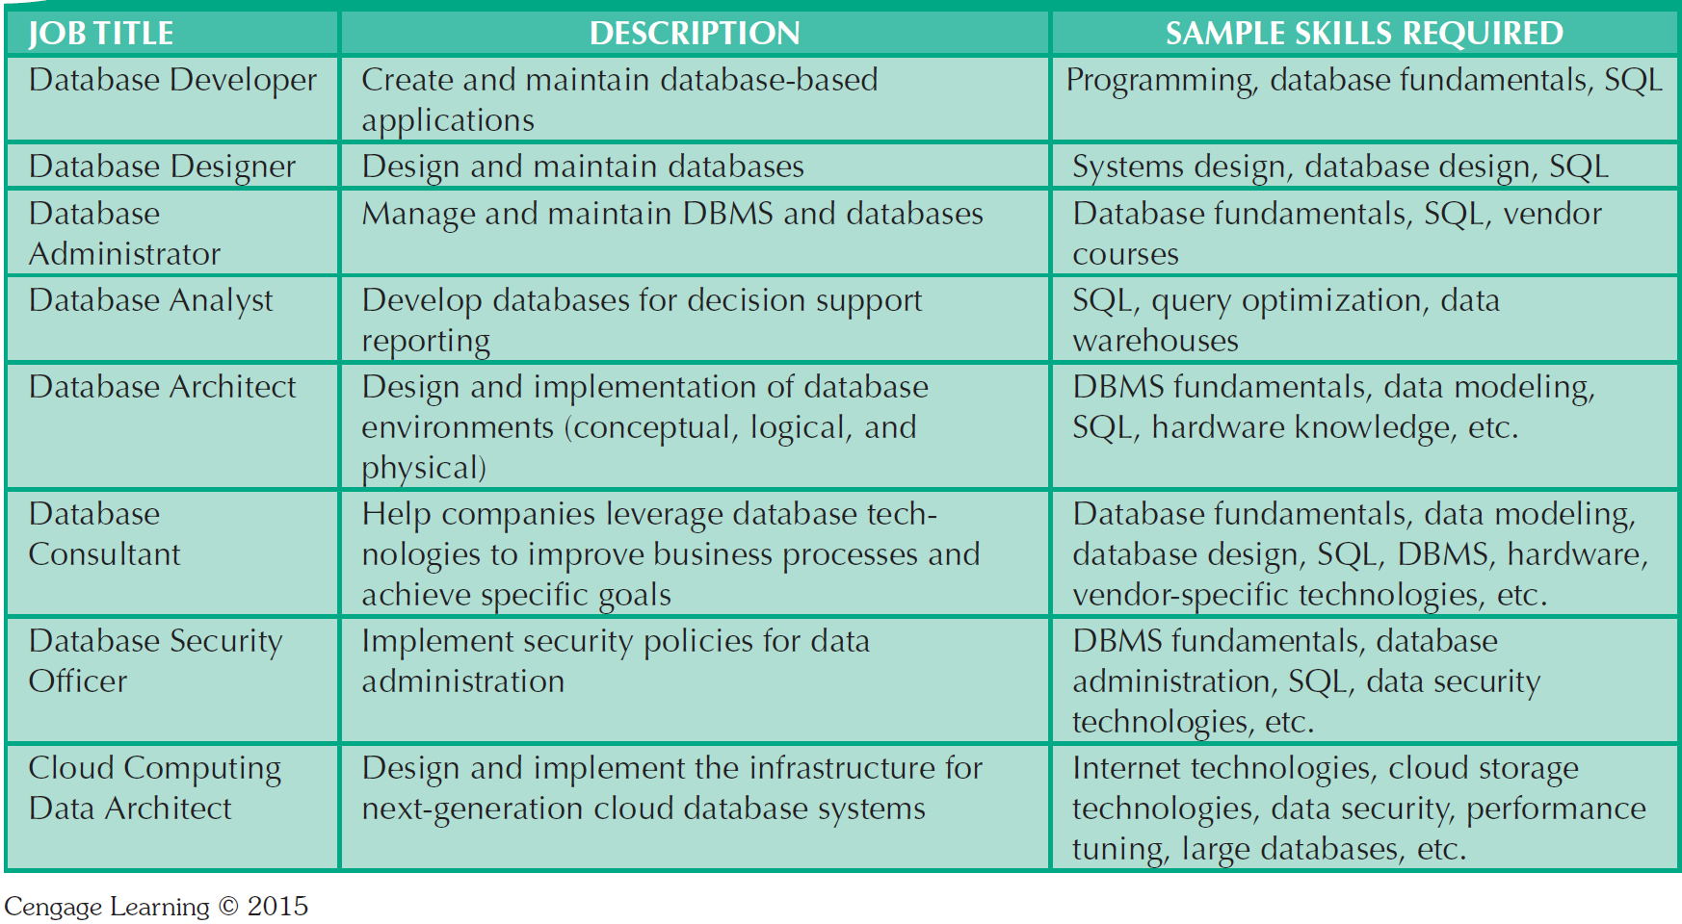
Database Career Opportunities

Slide 47
Summary
Data are raw facts. Information is the result of processing data to reveal its meaning.
To implement and manage a database, use a DBMS
Database design is very important
Databases were preceded by file system
DBMS’s were developed to address file systems’ inherent weaknesses
Notes:
47

